Slide 1

Integrated Health Monitoring Using Wearable Devices
Students: Rafael Linarez and Maria Sanchez
Mentor: Dr. Agoritsa Polyzou
Course: IDC-6940 - Capstone Course in Data Science - Fall 2024
Instructor: Dr. Ananda Mondal
Evaluation Committee: Dr. Dongsheng Luo

Slide 2


Introduction
30% of U.S. adults use wearables, 16% daily.[1]
90% of users are willing to share their data with healthcare providers.
Devices track activity, sleep, and heart rate.
Higher adoption: younger adults,higher incomes, and college-educated users.
Challenge: Data remains underutilized.
[1] Chiauzzi, E., Rodarte, C., & DasMahapatra, P. (2020). Patient-centered activity monitoring in the self-management of chronic health conditions. BMC Medicine, 18(1), 1–10. https://doi.org/10.1186/s12916-020-01859-1
[6]

Slide 3
What is the Problem?
Why This Matters
Wearable devices generate extensive data but lack actionable insights.
Sleep, activity, and heart rate data are often analyzed in isolation.
Missing data and variability challenge accurate predictions and behavior analysis.
Improved health through personalized recommendations.
Helps users optimize sleep, activity, and heart rate for better health outcomes.
Supports wearable tech in moving from data tracking to actionable guidance.

Slide 4
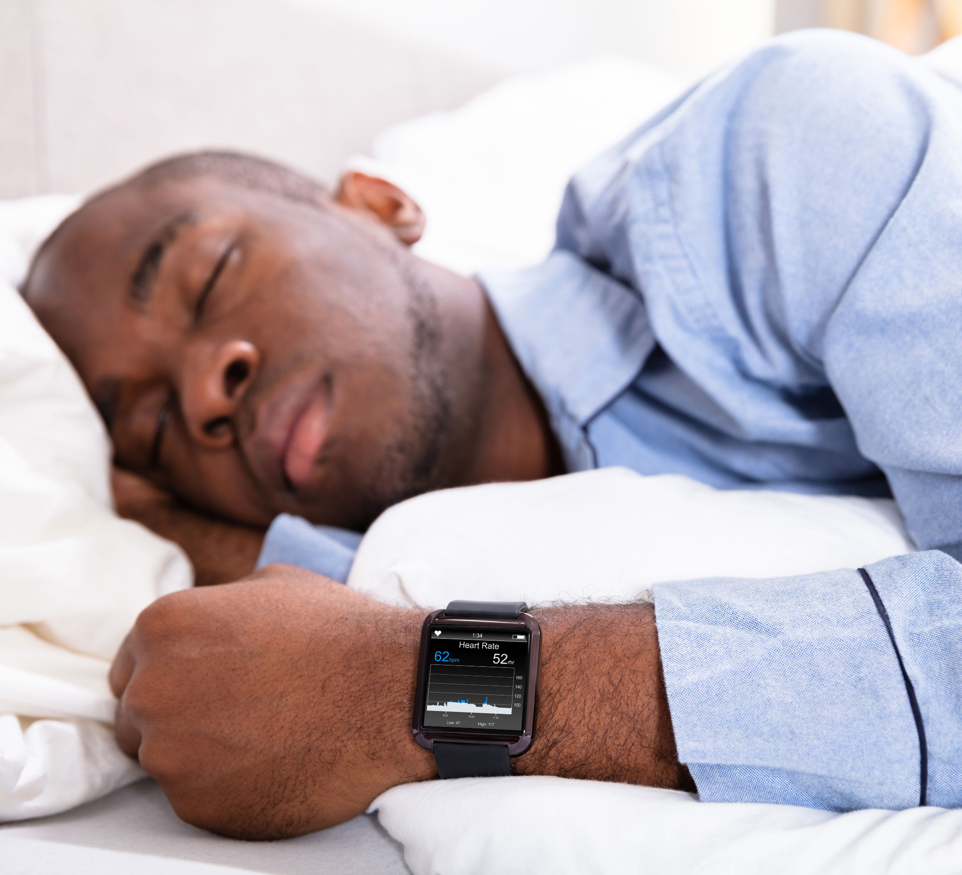
Assumption: The Connection Between Activity and Sleep
Assumption: Daily physical activity impacts sleep quality and quantity.
Hypothesis:
Increased activity → Better sleep outcomes
Falling asleep faster
Improved restfulness
Sedentary behavior → Poorer sleep quality
Longer sleep duration
Disrupted patterns.
[7]

Slide 5
Project Objective
Develop predictive models to forecast sleep outcomes using activity, METs (metabolic equivalent of task), and heart rate data.
Use clustering to classify users and identify common patterns.
Evaluate machine learning techniques for predicting sleep variables.
Provide insights for personalized health recommendations
Notes:
In this project, our primary objectives are fourfold:
To develop predictive models capable of forecasting sleep outcomes by leveraging data on user activity, metabolic equivalents (METs), and heart rate.
To assess the effectiveness of various machine learning techniques in predicting sleep-related variables.
To employ k-means clustering to categorize users, thereby uncovering prevalent patterns in their health metrics.
To derive actionable insights that can inform personalized health recommendations for users.
These objectives aim to enhance our understanding of the interplay between daily activities and sleep patterns, ultimately contributing to improved health outcomes.

Slide 6
Dataset Overview
Source: Survey via Amazon Mechanical Turk (April 12, 2016 - May 12, 2016)
Participants: 33 unique IDs
Dimensionality: 20 columns
Size: 941 observations
Details: Each record in the dataset is identified by a unique combination of Id and ActivityDate, indicating one user’s activity and sleep data for a single day.
Features Selected:
Activity_Record: Total steps, distance, active minutes, sedentary time.
Sleep_Record: Total minutes asleep, time in bed.
Heartbeat_Record: Max, min, average heart rate.
METs_Record: Energy expenditure from activities (METs, metabolic equivalent of task).

Slide 7
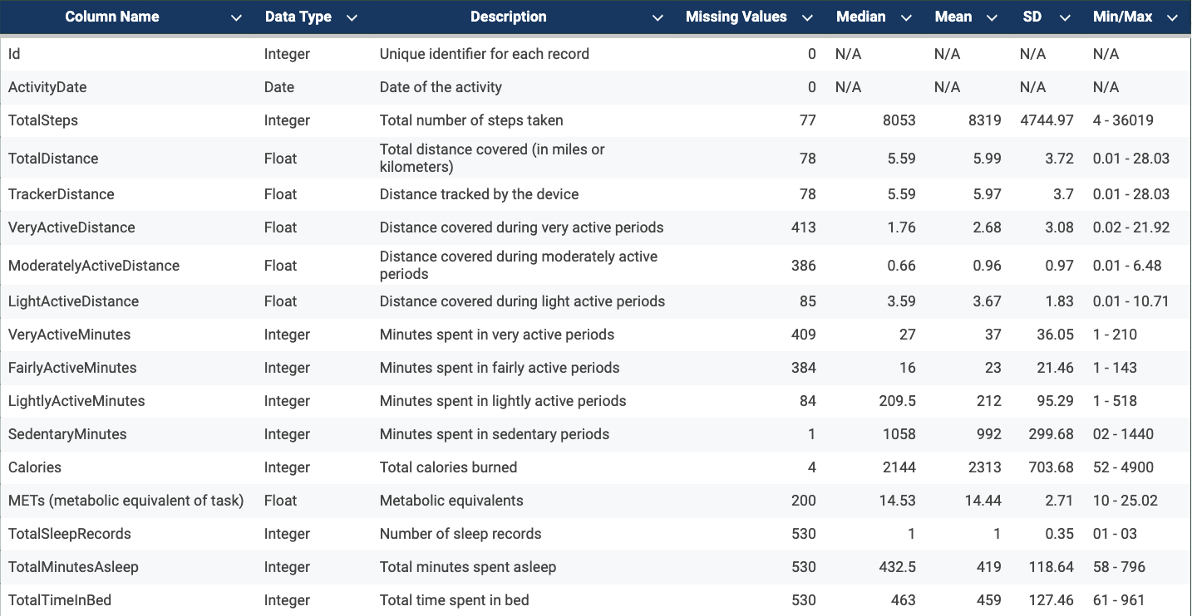
Dataset Overview

Slide 8
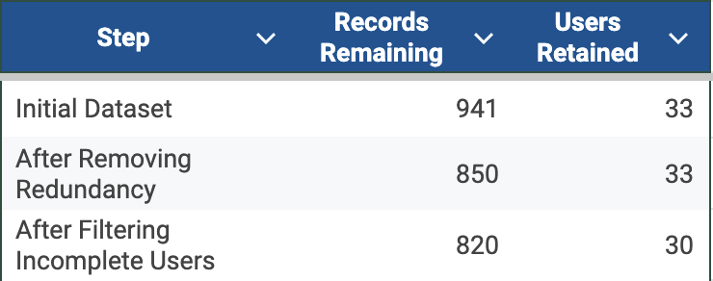
Data Cleaning
Actions Taken:
Removed records with SedentaryMinutes = 1440 (fully sedentary days).
Filtered out users with less than 15 days of activity data (<50% completeness).
Merged datasets on ‘Id’ and ‘ActivityDate’ to form a unified dataset.
Grouped data into categories: Activity, Sleep, Heartbeat, METs.
Why It’s Relevant:
Improves data quality and completeness.
Ensures metrics are aligned for effective clustering and predictions.
Lays the foundation for robust imputations and analysis.
Notes:
In the initial phase of our methodology, we focused on data cleaning to ensure the integrity and reliability of our dataset:
We removed records where SedentaryMinutes equaled 1,440, as these represent fully sedentary days and do not contribute meaningful activity information.
Users with less than 15 days of activity data were excluded to maintain at least 50% data completeness, ensuring sufficient data for analysis.
By merging datasets on Id and ActivityDate, we formed a unified dataset that consolidates all relevant information for each user on a daily basis.
We categorized the data into four main groups: Activity, Sleep, Heartbeat, and METs, facilitating targeted analyses within each category.
These steps were crucial in enhancing data quality and completeness, aligning metrics for effective clustering and predictive modeling, and establishing a solid foundation for robust imputations and subsequent analyses.

Slide 9
K Means Clustering
How can clustering based on sleep patterns and activity levels identify distinct groups of users, and what insights can these clusters provide about variations in sleep behavior and activity interactions? Purpose: Identify sleep behavior for each cluster.

Slide 10
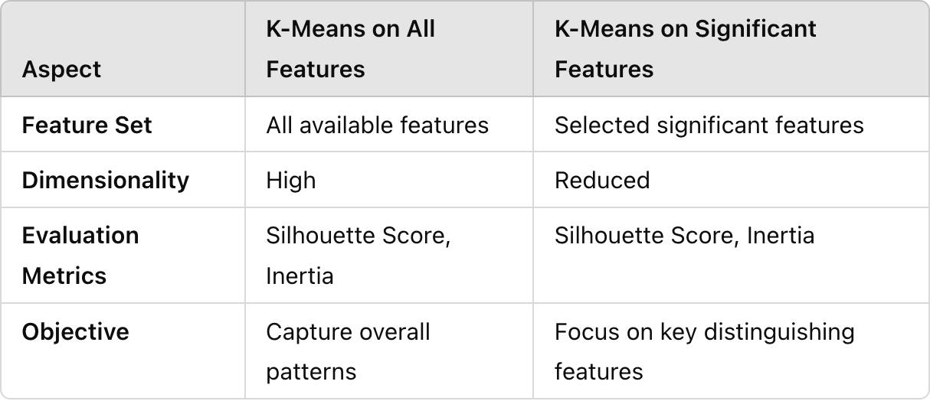
Methodology - Clustering
Objective: Identify distinct user activity patterns.
Clustering Approaches:
K-Means on All Features:
Applied to full feature set (excluding sleep data).
Evaluated using Silhouette Score & Inertia.
K-Means on Significant Features
Selected features based on mean differences.
Clustering evaluated with same metrics.

Slide 11
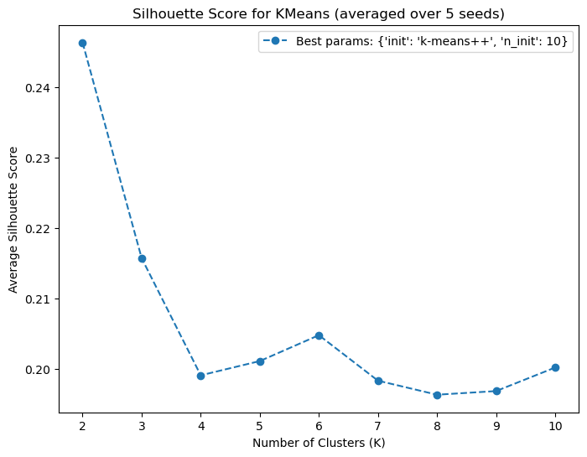
K-Means Clustering on All Features:
Objective: Segment users based on activity & physiological metrics to identify patterns.
Methodology:
Ran K-Means 5 times with different seeds & parameters, averaging results.
Applied K-Means with:
Initialization: 'k-means++'
Clusters (k): 2
n_init: 10
Random State: 100
Evaluation Metric:
Silhouette Score: 0.2464
Notes:
cluster separability was moderate with a Silhouette Score of 0.246

Slide 12
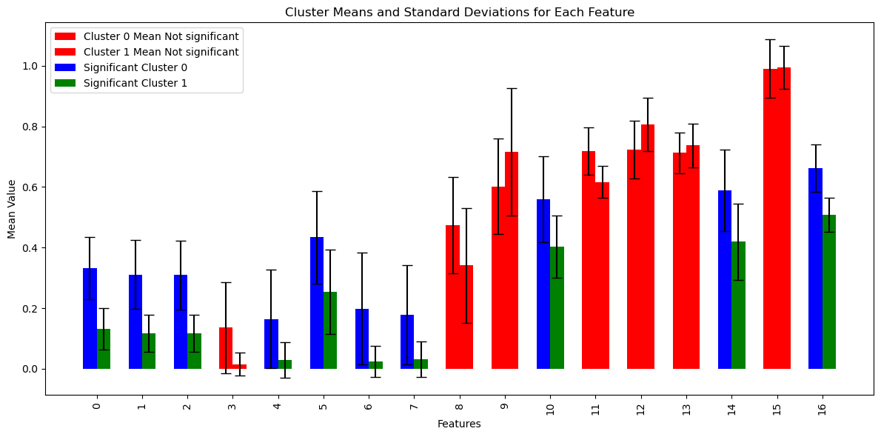
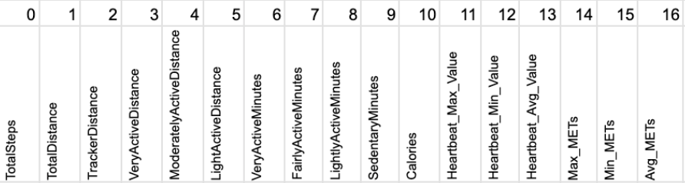
Means Clustering on Selected Significant Features
Feature Selection Process:
Excluded features with minimal differences between clusters (red).
Retained features with significant inter-cluster differences (blue & green).
Outcome:
Refined clustering by removing noise and focusing on key metrics.

Slide 13
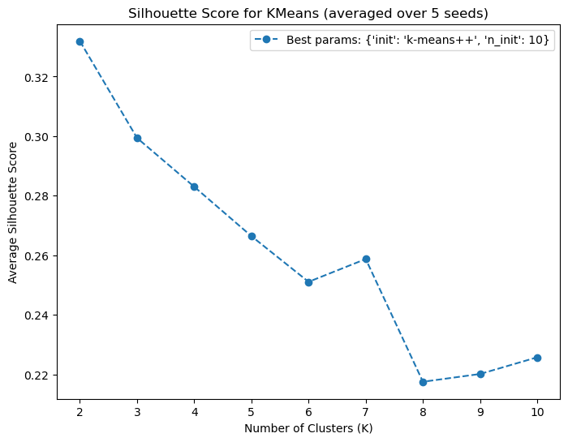
Methodology - K-Means Clustering on Selected Significant Features
Objective: Segment users based on selected features to identify distinct patterns.
Methodology:
Applied K-Means clustering on selected features, comparing mean & standard deviation across clusters.
Parameters:
Initialization: 'k-means++'
Clusters (k): 2
n_init: 10
Random State: 100
Silhouette Score: 0.33 (better than 0.246 from the "All Features" approach).
Key Improvement: Feature selection improved cluster definition, as seen in the higher Silhouette Score.

Slide 14
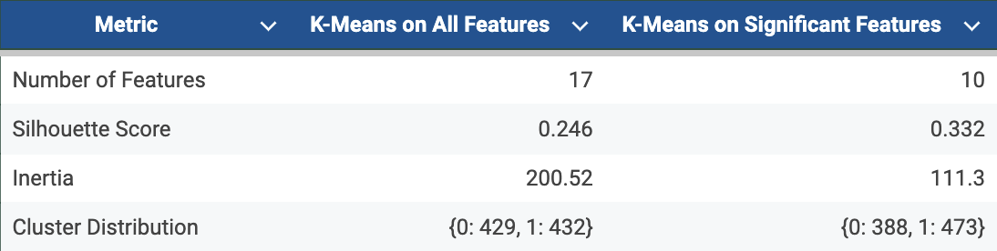
Comparison of Clustering Approaches
Silhouette Score: Measures how similar an object is to its own cluster compared to other clusters.
Inertia: Represents the sum of squared distances of samples to their closest cluster center.
Table: Comparison table K-means approaches
Notes:
Here, we present a comparative analysis of our two clustering approaches. The first method utilized all 17 features, resulting in a Silhouette Score of 0.246 and an Inertia of 200.52, with clusters distributed as follows: Cluster 0 containing 429 data points and Cluster 1 containing 432. The second method focused on 10 significant features, maintaining the same Silhouette Score of 0.246 but achieving a lower Inertia of 111.30. The cluster distribution in this case was: Cluster 0 with 388 data points and Cluster 1 with 473. This comparison highlights the impact of feature selection on clustering outcomes."

Slide 15
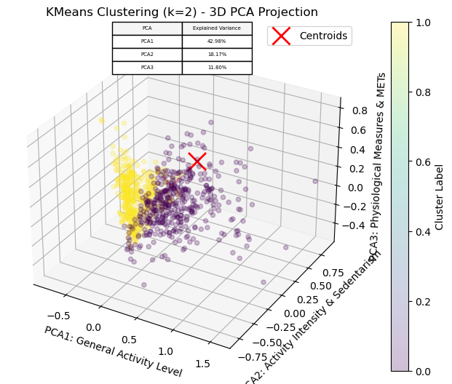
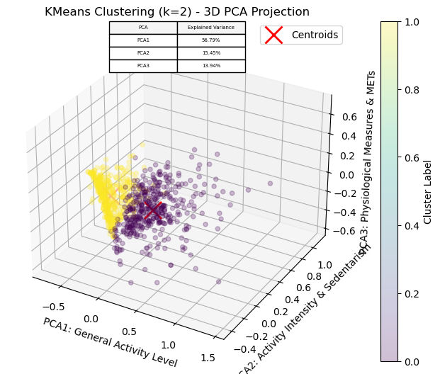
Visualization of Clusters
Visual 15.1: :K-Means Clustering on All Features
Visual 15.2: K-Means Clustering on Selected Significant Features

Slide 16
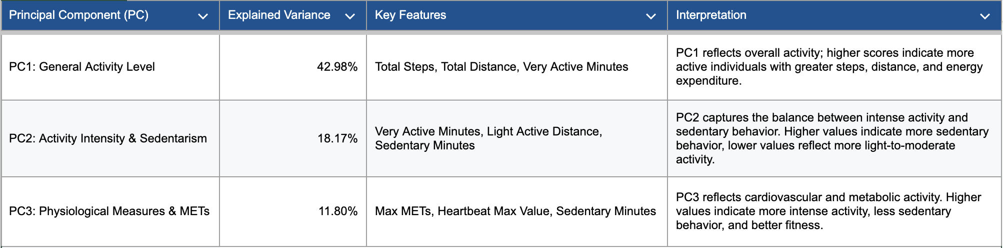
Insights: Clustering Validates Behavioral Segmentation
Distinct User Groups Identified:
Cluster 0: Consistent, moderate activity patterns, higher total steps.
Cluster 1: Patterns in Sedentary Minutes.

Slide 17
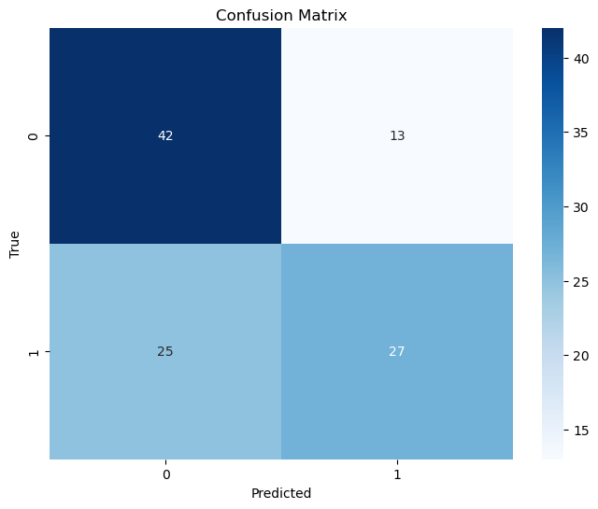
Methodology - KNN Classifier
Model Setup
Adding class labels: use the cluster assignments as class label for each data point of the dataset. (K-Means)
KNN for prediction: Predicted cluster assignments based on sleep records (Total Sleep Records, Minutes Asleep, Time in Bed).
Target Variable:
Class 0: Active_Users (higher activity)
Class 1: Sedentary_Users (lower activity)
Best hyperparameters based on average validation error: {'metric': 'manhattan', 'n_neighbors': 5, 'weights': 'uniform'}

Slide 18
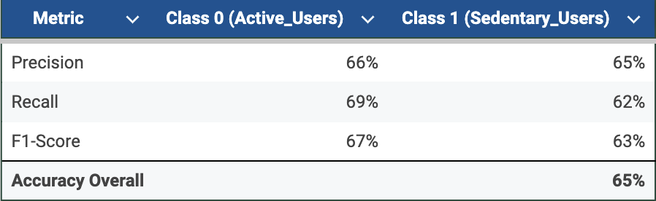
Methodology - KNN Classifier Results
Class Distribution in Test Set
Class 0 (Active_Users): 55 samples
Class 1 (Sedentary_Users): 52 samples
Insights:
Accuracy: 65% (reasonable performance in predicting clusters based on sleep data)
Cluster-Specific Performance:
Cluster 0: Precision = 66%, Recall = 69%
Cluster 1: Lower performance, indicating overlap with Cluster 0
Practical Use Case: The model can classify new users, offering tailored activity or sleep recommendations.

Slide 19
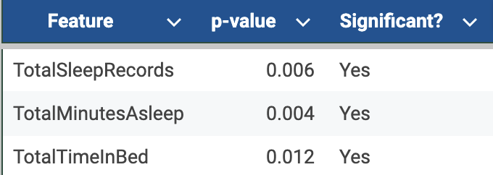
Statistical Validation of Clusters: ANOVA Results
Purpose: Validate sleep feature differences between clusters.
Methodology:
Conducted ANOVA tests on: TotalSleepRecords, TotalMinutesAsleep, TotalTimeInBed.
Null Hypothesis: No difference in feature means across clusters.
Key Insights:
Low p-values (< 0.05) confirm significant differences.
Validates clustering effectiveness in segmenting users by sleep behavior.
Notes:
The optimal clustering configuration was achieved using k-means++ with 10 initializations. The best number of clusters was determined to be 2, yielding a Silhouette Score of 0.246. This suggests that the data naturally forms two distinct groups, providing valuable insight for subsequent analysis.

Slide 20
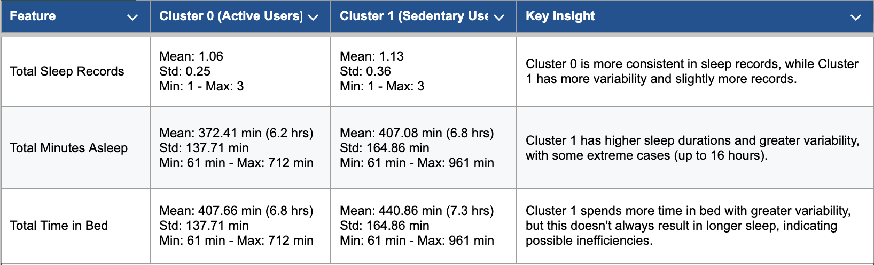
Insights: Feature Selection Improves Performance and Interpretability
Behavioral Segmentation: Clustering and predictive modeling revealed distinct user patterns (e.g., consistent vs. variable sleep/activity).

Slide 21
Insights: Feature Selection Improves Performance and Interpretability
Behavioral Segmentation: Clustering and predictive modeling revealed distinct user patterns (e.g., consistent vs. variable sleep/activity).

Slide 22
Insights: Feature Selection Improves Performance and Interpretability
Behavioral Segmentation: Clustering and predictive modeling revealed distinct user patterns (e.g., consistent vs. variable sleep/activity).

Slide 23
Predictive Modeling
How accurately can sleep outcomes (TotalSleepRecords, TotalMinutesAsleep, TotalTimeInBed) be predicted using activity levels, MET, and heart rate data?

Slide 24
Methodology
Step 3: Predictive Modeling
Step | Description | Techniques/Models
Raw Data | The dataset includes activity, METs, heart rate, and sleep metrics for each individual.
Step 1: Data Imputation | Address missing values for critical features such as sleep and heart rate metrics. | Imputation methods based on data distribution, Shapiro-Wilk test for normality.
Step 2: Normality Testing | Use Shapiro-Wilk to assess normality and determine appropriate imputation methods. | Shapiro-Wilk test for assessing normality.
Step 3: Predictive Modeling | Predict sleep outcomes using activity, METs, and heart rate data. | XGBoost, SVR, KNN, Ridge, Lasso, Elastic Net Regression, Decision Tree Regression.
End: Predicted Metrics | Outcome: Predicted sleep metrics such as TotalSleepRecords, TotalMinutesAsleep, TotalTimeInBed. | Models evaluated based on error metrics (MSE).
Notes:
In the 3rd step of our methodology, we focused on predictive modeling with the objective of forecasting sleep outcomes—specifically, Total Sleep Records, Total Minutes Asleep, and Total Time in Bed—based on activity, METs, and heart rate data.
Our approach involved several key components:
Data Imputation: We addressed missing values in critical features, particularly in sleep and heart rate metrics, to ensure a complete dataset for analysis.
Normality Testing: We applied the Shapiro-Wilk test to assess the normality of our data distributions. This informed our choice of modeling and imputation techniques, ensuring they were appropriate for the data's characteristics.
Machine Learning Models: We implemented and evaluated a range of machine learning models to identify the most effective predictors of sleep outcomes. These models included:
XGBoost, Support Vector Regression (SVR), and K-Nearest Neighbors (KNN)
Ridge, Lasso, and Elastic Net Regression
Decision Tree Regression
By systematically applying these models, we aimed to uncover the relationships between activity, METs, heart rate data, and sleep outcomes, thereby enabling more accurate predictions and personalized health recommendations.

Slide 25
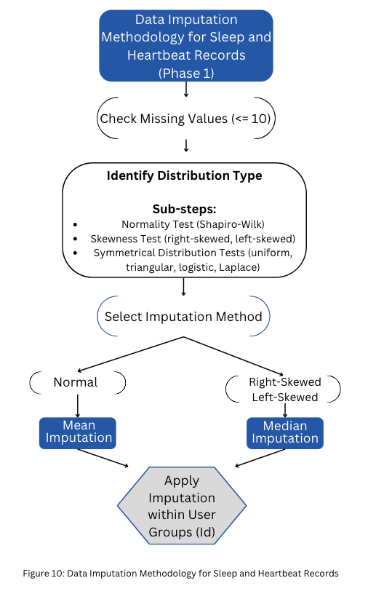
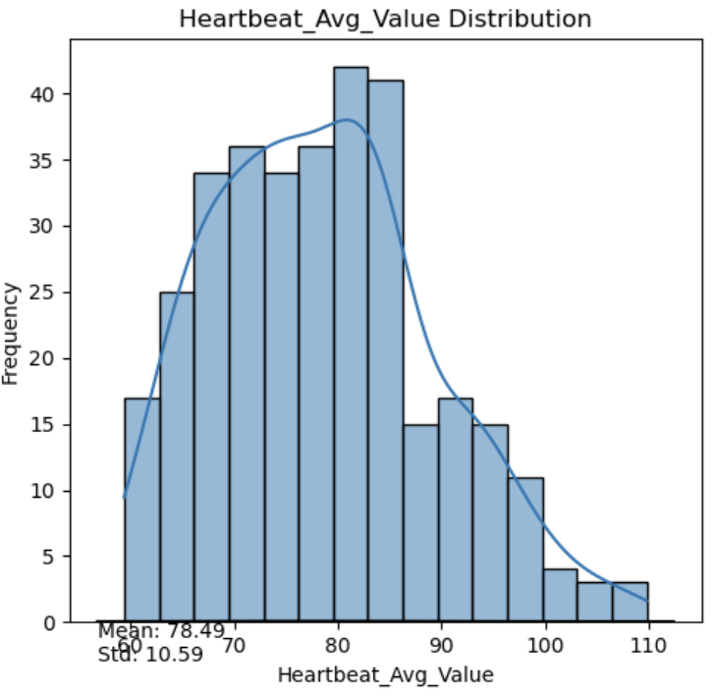
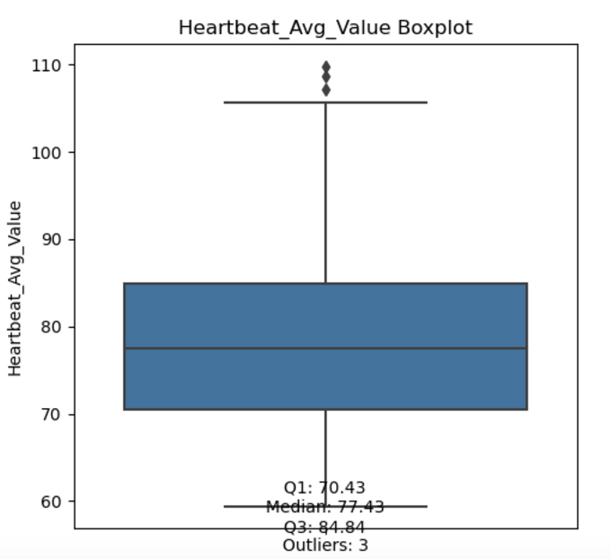
Assessing Data Normality
Objective: Address missing values in key features to ensure data completeness for robust analysis Approach:
Distribution Analysis: Assessed the distribution of each feature to determine the appropriate imputation method.
Imputation Methods:
Mean, and Median Imputation.
Normality testing
Implementation:
Imputation was conducted on a per-user basis to preserve individual patterns and trends.
Ensured that imputed values were within plausible ranges based on existing data.
.

Slide 26
Predictive Modeling Overview
Machine Learning Models Implemented:
The following models were used for predictive modeling, balancing interpretability, regularization, and prediction accuracy:
Ridge, Lasso, Elastic Net Regression
Support Vector Regression (SVR)
K-Nearest Neighbors (KNN)
XGBoost
Decision Tree Regression
A baseline model was also calculated to benchmark performance. Details will be explained later.

Slide 27
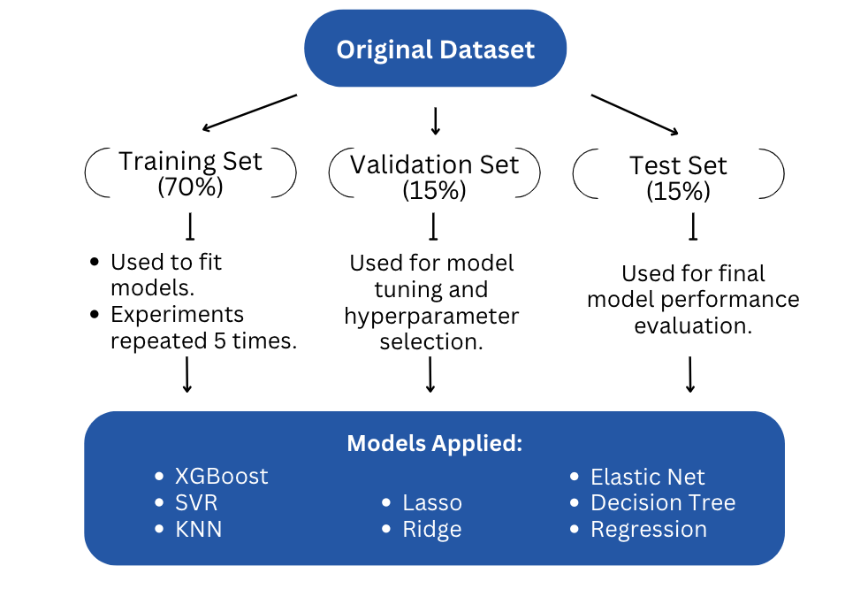
Experimental Setup
Notes:
In this step of the methodology, we split the dataset into three subsets: 70% for training, 15% for validation, and 15% for testing. This distribution ensures that we have enough data to fit the models, tune hyperparameters, and independently evaluate their performance.
To make our results more reliable, we repeated the experiments five times, using different splits each time. By averaging the outcomes, we minimized the impact of randomness and ensured that our findings are robust.
As for the models, we tested various machine learning algorithms, including XGBoost, Support Vector Regression (SVR), K-Nearest Neighbors (KNN), Elastic Net, Ridge, Lasso, Decision Trees, and standard regression methods. These models allowed us to explore a variety of predictive approaches, each with strengths in handling different types of data relationships and complexities.
The training set was used to fit the models, the validation set helped in hyperparameter tuning, and the test set provided a final unbiased evaluation of model performance.

Slide 28
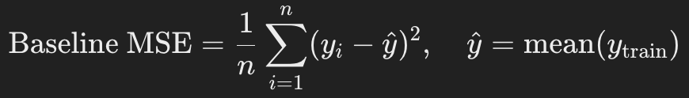
Baseline Comparison for Sleep Metrics
Baseline Formula: (use mean of the target variable)
Baseline MSEs results:
TotalSleepRecords: 0.0084
TotalMinutesAsleep: 0.0355
TotalTimeInBed: 0.0288
Why Baseline?
Provides a benchmark for comparing model performance.
Quantifies error reduction (e.g., XGBoost reduced error by 70%+ for all metrics).
Highlights the prediction task's complexity.
Notes:
MSE measures the average squared difference between predicted and actual values, emphasizing larger errors.

Slide 29
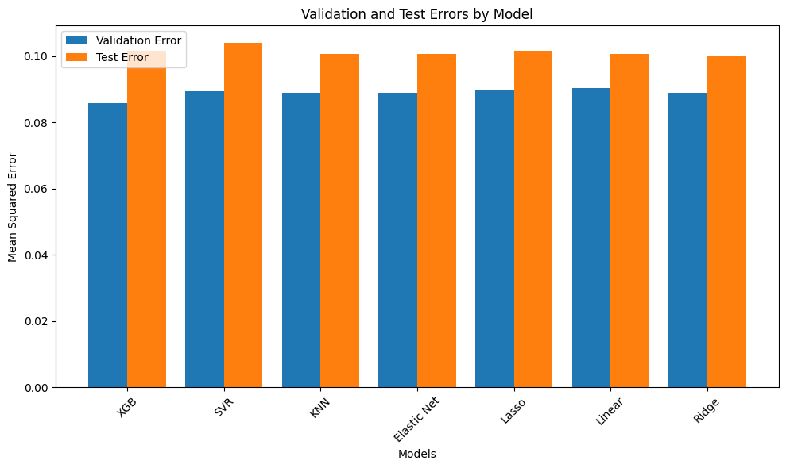
Model Performance: Validation vs. Test Errors
Target Variable:TotalSleepRecords
XGBoost (XGB): Lowest Validation Error (0.0858) and Test Error (0.1016), generalizes best.
Other Models: SVR, KNN, Elastic Net, Lasso, Linear, Ridge perform similarly (~0.089-0.090) but worse than XGB.
Test Error > Validation Error: Indicates slight overfitting. Address with more data or regularization.
Notes:
This graph compares the Validation and Test Errors for different models used to predict Total Sleep Records. The most important observation here is that XGBoost (XGB) outperforms all other models with the lowest Validation Error of 0.0858 and Test Error of 0.1016, which shows it generalizes better to unseen data. This highlights its capability to capture complex patterns in the dataset.
On the other hand, SVR, KNN, Elastic Net, Lasso, Linear Regression, and Ridge models all have Validation Errors clustered around 0.089-0.090, indicating similar but slightly inferior performance compared to XGBoost.
One key insight from this graph is that for all models, the Test Error is higher than the Validation Error, which suggests a degree of overfitting to the validation data. This could mean that the models are learning patterns specific to the validation set rather than generalizing to new data. Addressing this might involve increasing the training data size or applying stronger regularization.
To summarize, XGBoost is the most effective model for this task, and future efforts should focus on fine-tuning its hyperparameters or expanding the dataset to improve generalization even further.

Slide 30
Performance of Models for Predicting Total Minutes Asleep
Target: Total Minutes Asleep
Model | Target | Average_Train_MSE | Average_Val_MSE | Average_Test_MSE
XGB | TotalMinutesAsleep | 0.0194 | 0.1095 | 0.1321
SVR | TotalMinutesAsleep | 0.1026 | 0.1198 | 0.1403
KNN | TotalMinutesAsleep | 0 | 0.1206 | 0.1397
Elastic Net | TotalMinutesAsleep | 0.1416 | 0.1542 | 0.1655
Lasso | TotalMinutesAsleep | 0.1612 | 0.1774 | 0.1858
Linear | TotalMinutesAsleep | 0.125 | 0.1354 | 0.1518
Ridge | TotalMinutesAsleep | 0.1257 | 0.1364 | 0.1535
Insight:
XGB achieves the best performance with the lowest error metrics, making it the most reliable model for predicting TotalMinutesAsleep.

Slide 31
Performance of Models for Predicting Total Time In Bed
Target: Total Time In Bed
Model | Target | Average_Train_MSE | Average_Val_MSE | Average_Test_MSE
XGB | TotalTimeInBed | 0.0168 | 0.1004 | 0.1174
SVR | TotalTimeInBed | 0.0916 | 0.1079 | 0.1294
KNN | TotalTimeInBed | 0 | 0.1079 | 0.1255
Elastic Net | TotalTimeInBed | 0.1243 | 0.1361 | 0.1475
Lasso | TotalTimeInBed | 0.1433 | 0.1592 | 0.1655
Linear | TotalTimeInBed | 0.1092 | 0.1172 | 0.1325
Ridge | TotalTimeInBed | 0.1097 | 0.1181 | 0.1341
Insight:
XGB provides the most accurate predictions for TotalTimeInBed, demonstrating the importance of complex models for this task.

Slide 32
Performance of Models for Predicting Total Sleep Records
Target: Total Sleep Records
Model | Target | Average_Train_MSE | Average_Val_MSE | Average_Test_MSE
XGB | TotalSleepRecords | 0.0706 | 0.0858 | 0.1016
SVR | TotalSleepRecords | 0.1066 | 0.0893 | 0.104
KNN | TotalSleepRecords | 0 | 0.0889 | 0.1006
Elastic Net | TotalSleepRecords | 0.1028 | 0.089 | 0.1006
Lasso | TotalSleepRecords | 0.1047 | 0.0896 | 0.1016
Linear | TotalSleepRecords | 0.0982 | 0.0904 | 0.1006
Ridge | TotalSleepRecords | 0.1001 | 0.089 | 0.1
Insight:
XGB leads in prediction accuracy for TotalSleepRecords, closely followed by KNN and SVR, with simpler models showing slightly higher errors.

Slide 33
Insights: Data-Driven Personalization and Reliable Predictions
Importance of Handling Missing Data:
Imputation: Used Gradient Boosting & Linear Regression to maintain data integrity and trends.
Addressed gaps in sleep & heart rate data, crucial for wearable tech analysis.
Reliable Sleep Forecasting
XGBoost: Lowest MSE for sleep outcomes (Total Sleep Records, Minutes Asleep, Time in Bed).
Ridge & Lasso Regression: Reduced overfitting, ensuring reliable predictions.

Slide 34
Conclusion
What We Did:
Used clustering and predictive modeling to analyze physical activity and sleep behaviors from wearable data, focusing on feature selection, imputation, and model refinement.
Key Insights:
Higher activity levels link to better sleep (shorter duration, improved restfulness).
Sedentary behavior leads to poorer sleep quality and longer, disrupted sleep.
XGBoost was the best model for sleep forecasting.
Clustering identified consistent vs. variable behavior groups, validated by PCA and ANOVA.
Actionable Takeaways:
Wearable devices can use clustering and modeling for personalized recommendations to improve sleep and activity balance.

Slide 35

Future Work
Short-Term Goals:
Test models on larger, diverse datasets.
Add health metrics like stress, diet, and hydration.
Long-Term Goals:
Develop real-time prediction and clustering models for wearables.
Integrate insights into personalized sleep improvement recommendations.
[5]

Slide 36
References
Chiauzzi, E., Rodarte, C., & DasMahapatra, P. (2020). Patient-centered activity monitoring in the self-management of chronic health conditions. BMC Medicine, 18(1), 1–10. https://doi.org/10.1186/s12916-020-01859-1
Müller, M., Schmidt, J., & Wang, K. (2024). Personalized interpretable prediction of perceived sleep quality from wearable sensor data. PLOS ONE. https://doi.org/10.1371/journal.pone.0305258
Brown, L., Green, M., & White, P. (2023). How are different clusters of physical activity, sedentary, sleep, and diet associated with health indicators in adolescents? Journal of Activity, Sedentary and Sleep Behaviors. https://doi.org/10.1186/s44167-023-00025-5
Kinnunen, S., Rantanen, M., & Saari, T. (2024). Predicting sleep based on physical activity, light exposure, and heart rate variability data. Annals of Medicine. https://doi.org/10.1080/07853890.2024.2405077
SimplyTek.lk. (n.d.). Fitbit Charge 5. Retrieved December 4, 2024, from https://www.simplytek.lk/cdn/shop/files/fit-bit-charge5-simplyteklk-2.jpg?v=1694425868&width=1220
Eastwood, B. (2024, March 29). The latest trends in wearable technology for healthcare. HealthTech Magazine. Retrieved from https://healthtechmagazine.net/article/2024/03/trends-wearable-technology-for-healthcare-perfcon
American Academy of Sleep Medicine. (2023, November). Man with Fitbit wearable [Photograph]. Retrieved from https://aasm.org/wp-content/uploads/2023/11/Man-with-Fitbit-wearable.png

Slide 37


